Slide 1



Optimizing Multi-Layer Radiation Absorbing Materials: Advanced Algorithmic Solutions
Joey Antonucci, Tegan Carr, Abegale Jones
Sponsored by
Faculty: Dr. Paul Leu, Dr. Jungtaek Kim, Mr. Mingxuan Li
DEVCOM: Dr. Quang Nguyen

Slide 2

Radiation-absorbing coatings are more than just a tool for stealth—they’re a gateway to a smarter, safer, and more efficient future.

Slide 3
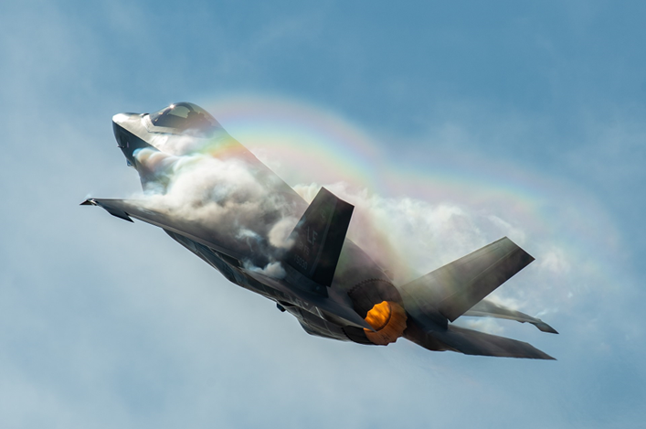
Radiation Absorbing Material Coatings are Widely Used in a Variety of Military and Civil Applications
Military Applications:
Aircraft
  Stealth fighters, bombers
Missiles
  Cruise and ballistic missiles
Ground Vehicles
  Tanks and armored vehicles
Naval Vessels
  Surface ships, submarines
Satellites
Wikipedia contributors. (2024, November 29). Lockheed Martin F35 A.

Slide 4
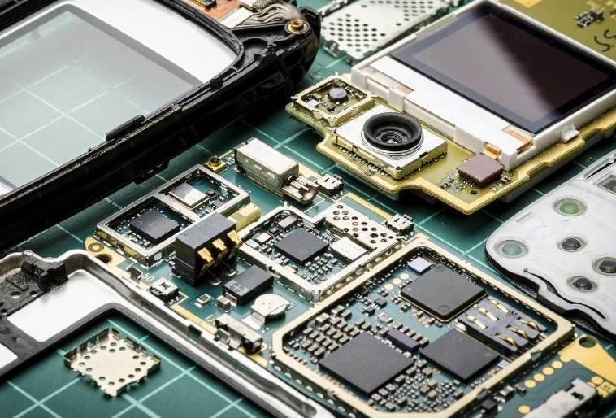
Radiation Absorbing Material Coatings are Widely Used in a Variety of Military and Civil Applications
Civil Applications:
Telecommunications
  Signal management
Automotive Industry
  Electric vehicles
Architecture and Construction
  Energy efficiency
Consumer Electronics
  Smartphones, laptops, tablets
DeepCoat. (n.d.). How EMI shielding protects cell phones. DeepCoat. Retrieved November 29, 2024

Slide 5
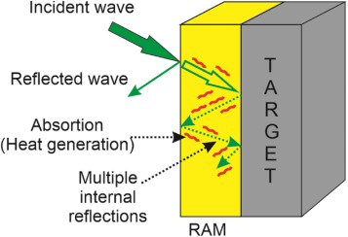
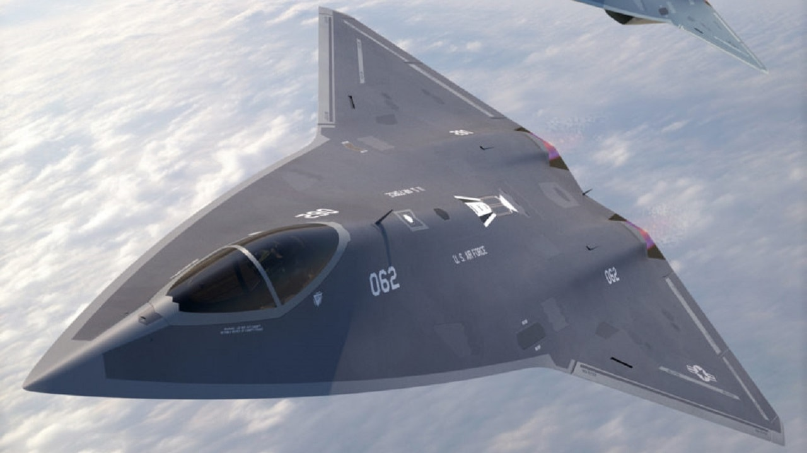
Radiation Absorbing Materials Minimize Radar Detection by Converting Electromagnetic Waves into Heat or Destructive Interference
Wang, X. (2024). Radar absorbing material. Radar Absorbing Material - an overview | ScienceDirect Topics. https://www.sciencedirect.com/topics/materials-science/radar-absorbing-material
Notes:
RAM is designed to absorb incoming radar waves instead of reflecting them. This is achieved through materials that have specific electromagnetic properties, such as a high magnetic or dielectric loss, which convert the electromagnetic energy into heat.

Slide 6
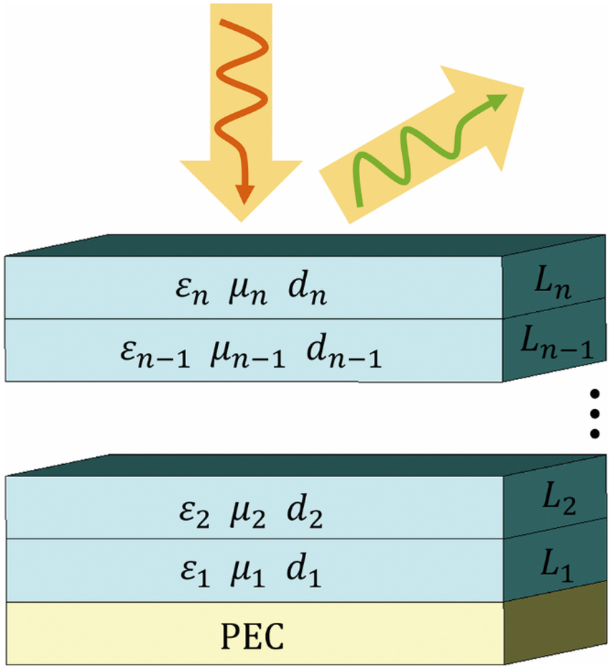
RAM Advancements use Nanomaterials, Optimized Structures, and Algorithm-driven Simulations to Enhance Absorption and Stealth Performance
Notes:
The development of advanced RAM technology increasingly relies on computational tools and algorithms to optimize material composition and performance. Genetic algorithms, machine learning, and Bayesian optimization are employed to explore the vast design space of potential material combinations. These methods simulate interactions between electromagnetic waves and materials, evaluating properties like dielectric constants, magnetic permeability, and layer thicknesses.

Slide 7

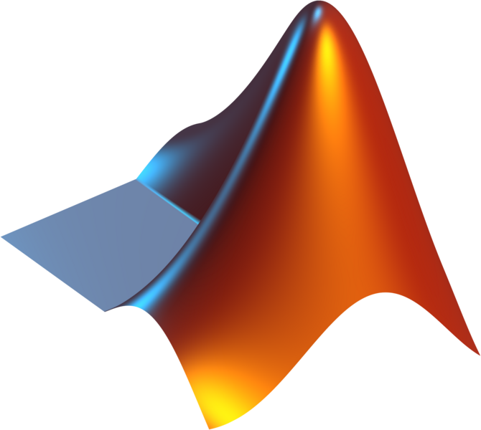

Building on Existing Work: Advancing the Project Through Prior Foundations
Existing Python Codebase in GitHub
MATLAB Contributions by Sponsor
Published Research on Genetic Algorithms

Slide 8
Objective: Optimize Mutli-Layer Radiation Absorbing Materials
Using Algorithms

Slide 9

Make a Template for ARL to Import Materials
The Material Must be Thin and Easy to Manufacture
Import 16 fictious materials
Create air and PEC layers surrounding material
Maximum of 5 material thick
Total material thickness < 7 mm
Requirements
&
Specifications
Minimize Total Radar Reflection
Efficiently Execute
MATLAB & Python Scripts
Keep reflection of broad-band frequencies under –30 dB
Vectorize FOR Loops
Genetic Algorithm (GA)
Bayesian Optimization

Slide 10
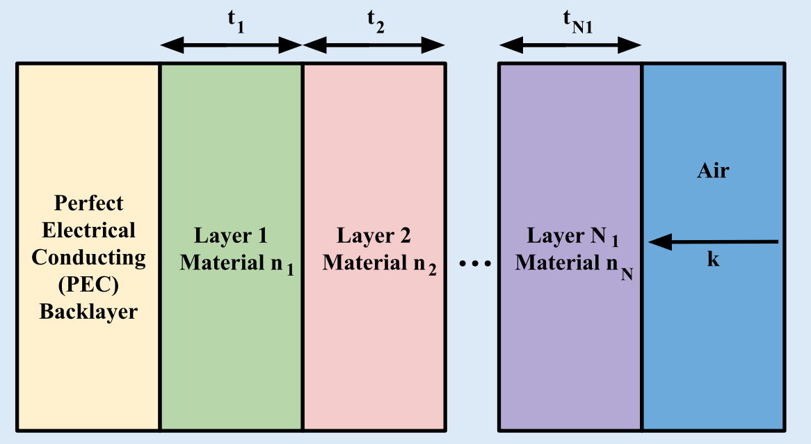
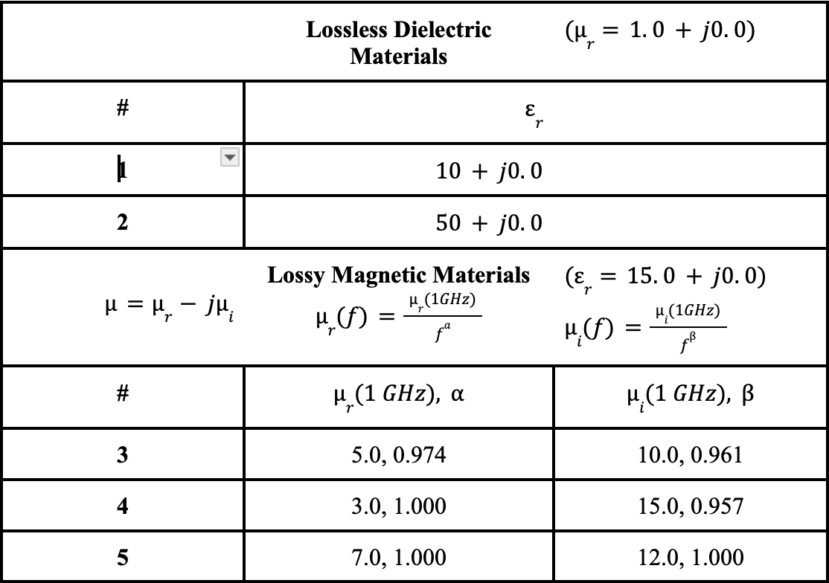
Make a Template for ARL to Import
Materials
Import 16 fictious materials
Create air and PEC layers surrounding material
Relative Permitivities and Permeabilities
of the Materials in the Database

Slide 11
The Material Must be Thin and Easy to Manufacture
Maximum of 5 materials thick
Total material thickness < 7 mm

Slide 12
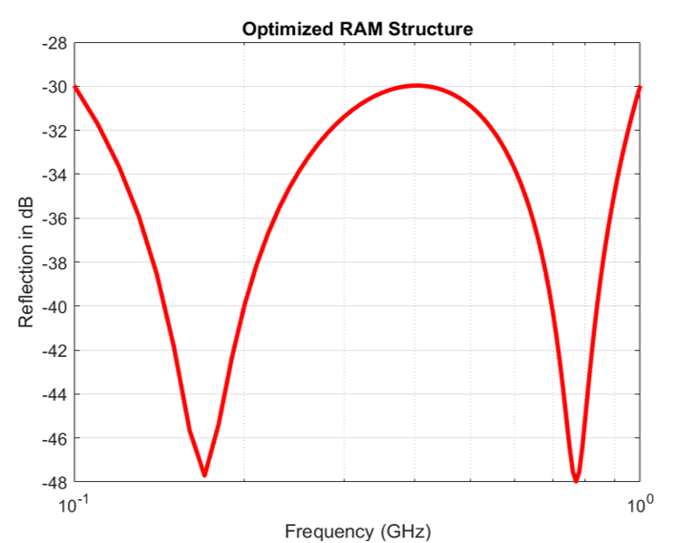
Minimize Total Radar Reflection
Keep reflection of broad-band frequencies under –30 dB

Slide 13

Efficiently Execute
MATLAB & Python Scripts
Vectorize FOR Loops
Genetic Algorithm (GA)
Bayesian Optimization

Slide 14
What is the Best Method to Optimize a Multi-Layer Radiation Absorbing Material?

Slide 15
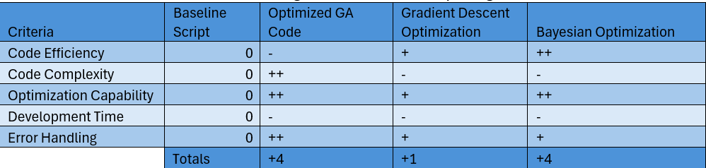
A Pugh Chart was Used to Down Select Design Criteria
Pugh Chart of Preliminary Designs:

Slide 16
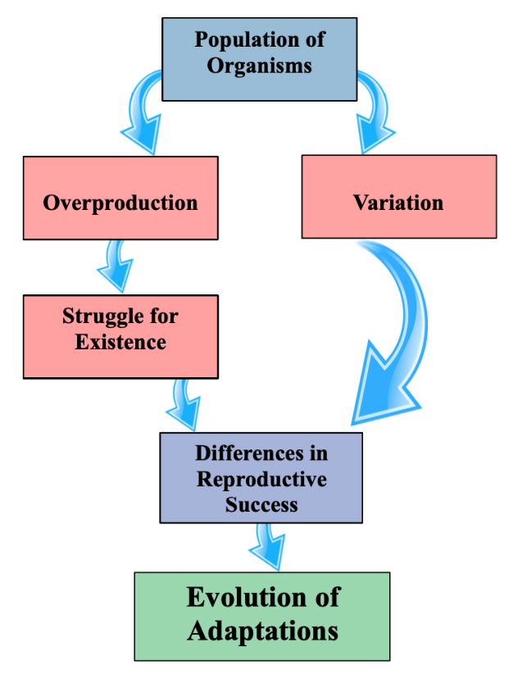
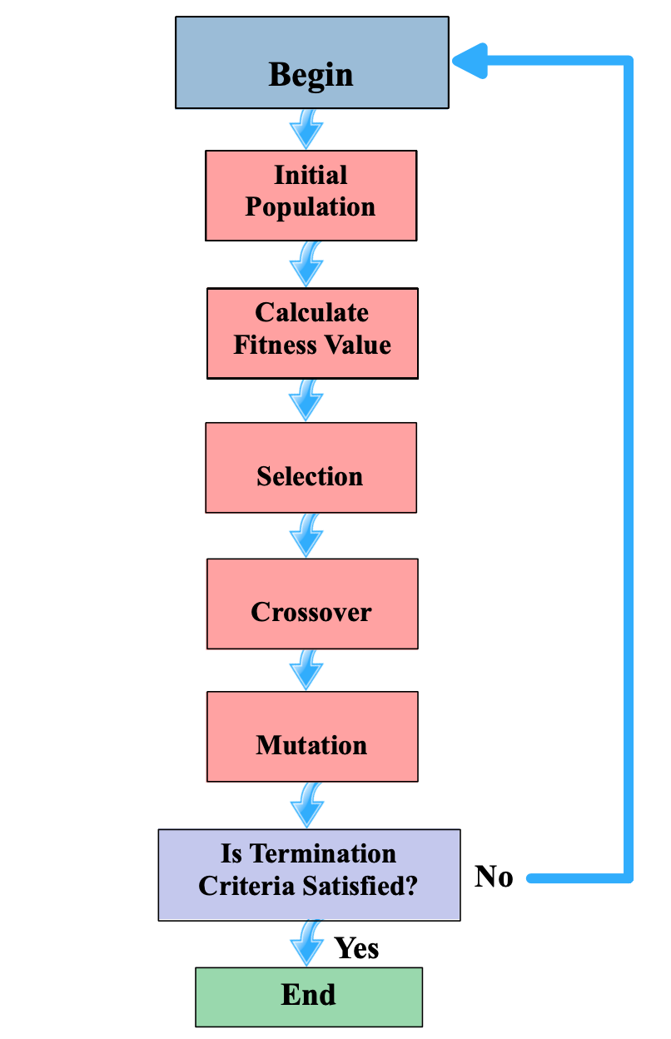
A Genetic Algorithm Mimics the Process of
Natural Selection to Evolve Solutions
Genetic Algorithm:
Natural Selection:

Slide 17
A Random Initial Population Allows for More Exploration of the Solution Space
1 Chromosome
0.10 2.56 4.89 1 14 13
3.45 1.32 0.78 4 8 15
2.17 2.01 1.64 5 12 9
3.00 0.24 0.74 2 10 2
Random
Population
of 4
1st Generation
Thickness
Material

Slide 18
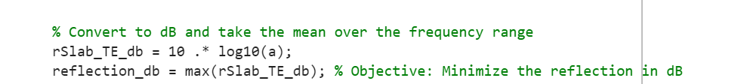
A Fitness Functio​n Guides the Algorithm Toward Selecting an Optimal Solution
1 Chromosome
0.10 2.56 4.89 1 14 13
3.45 1.32 0.78 4 8 15
2.17 2.01 1.64 5 12 9
3.00 0.24 0.74 2 10 2
R = -20.45 [dB]
Random
Population
of 4
R = -31.01 [dB]
R = -30.30 [dB]
R = -27.19 [dB]
1st Generation
Thickness
Material

Slide 19
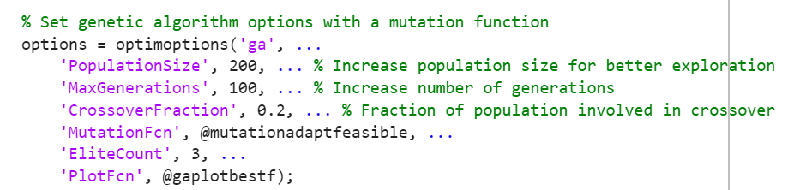
Crossover and Mutation Allow the Solution to Evolve Over Generations
1 Chromosome
0.10 2.56 4.89 1 8 13
3.45 1.32 0.78 4 14 15
2.17 2.01 1.64 5 12 9
3.00 0.24 0.74 2 10 2
R = -19.82 [dB]
Random
Population
of 4
R = -36.90 [dB]
R = -30.30 [dB]
R = -27.19 [dB]
2nd Generation
Thickness
Material

Slide 20
Crossover and Mutation Allow the Solution to Evolve Over Generations
1 Chromosome
0.10 2.56 4.89 1 8 13
3.45 1.32 0.78 4 14 15
1.25 2.01 1.64 5 12 9
3.00 0.24 0.74 2 10 2
R = -19.82 [dB]
Random
Population
of 4
R = -36.90 [dB]
R = -21.10 [dB]
R = -27.19 [dB]
2nd Generation
Thickness
Material

Slide 21
Crossover and Mutation Allow the Solution to Evolve Over Generations
1 Chromosome
0.10 2.56 4.89 1 8 13
3.45 1.32 0.78 4 14 15
1.25 2.01 1.64 5 12 9
3.00 0.24 0.74 2 10 2
R = -19.82 [dB]
Random
Population
of 4
R = -36.90 [dB]
R = -21.10 [dB]
R = -27.19 [dB]
2nd Generation
Thickness
Material

Slide 22
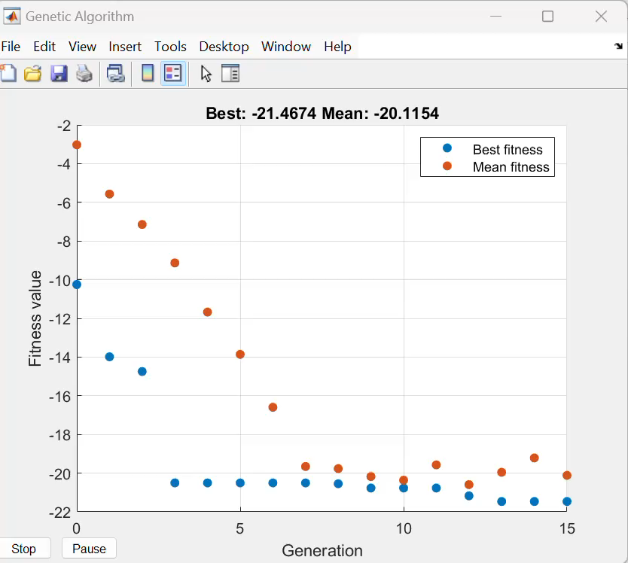
Genetic Algorithms Converge on an Optimal Solution

Slide 23
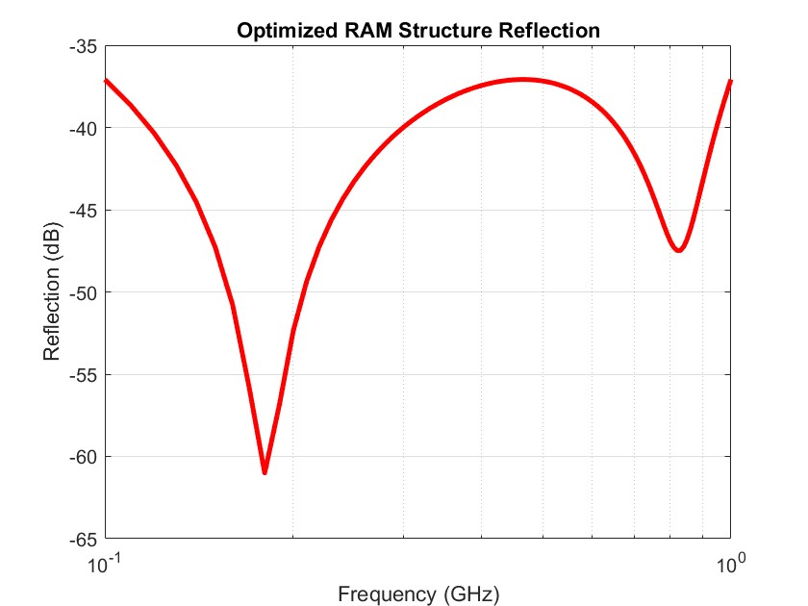
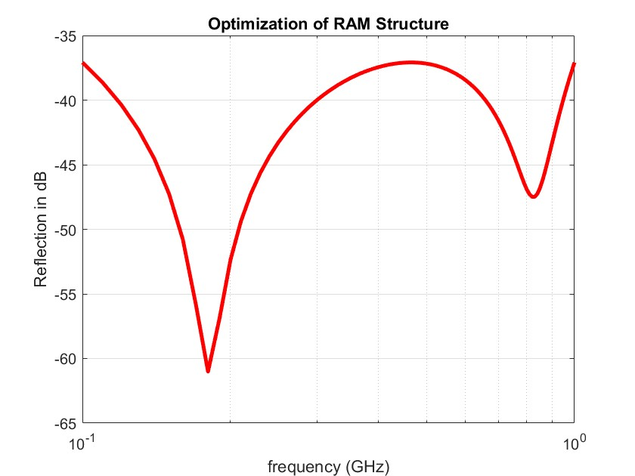
Results are Validated by Comparing Values to
Proven MATLAB Code
Genetic Algorithm Results
Proven MATLAB Results

Slide 24
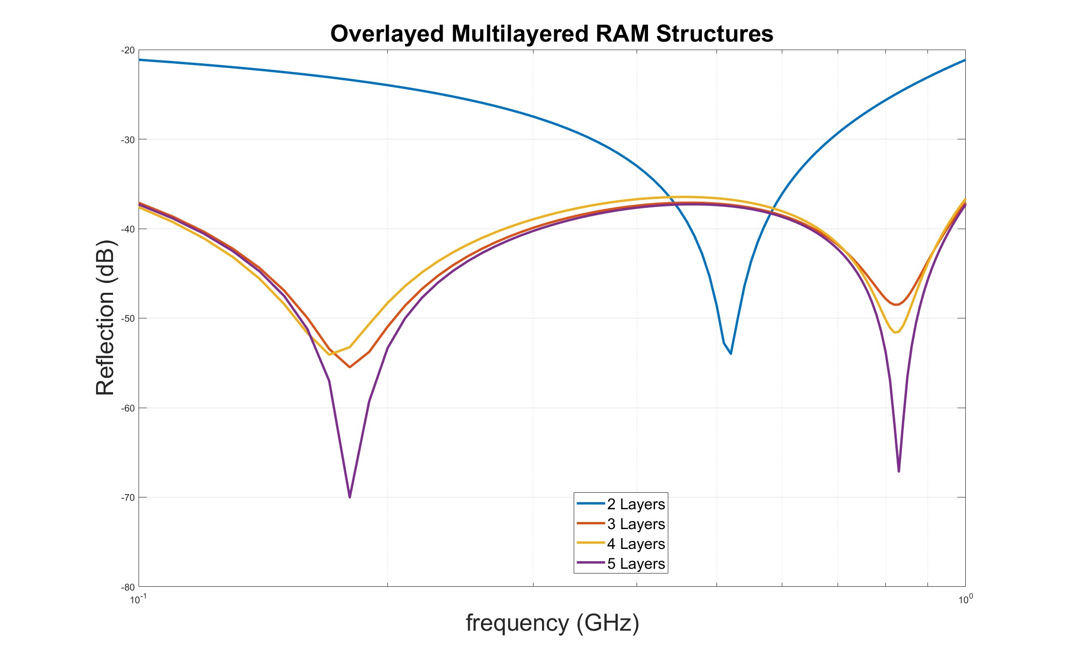
Overlaying Data from Multiple Layers Allows us to Compare Results
2 Layer:
t = [3.25 0.26] (mm)
M = [4 6]
R = -21.13 (dB)
3 Layer:
t = [3.81 1.39 1.46] (mm)
M = [4 8 15]
R = -37.10 (dB)
4 Layer:
t = [3.81 0.15 1.42 1.44] (mm)
M = [4 15 8 15]
R = -36.46 (dB)
5 Layer:
t = [3.58 1.61 0.78 0.67 0.24] (mm)
M = [4 8 15 16 4]
R = -37.28 (dB)

Slide 25
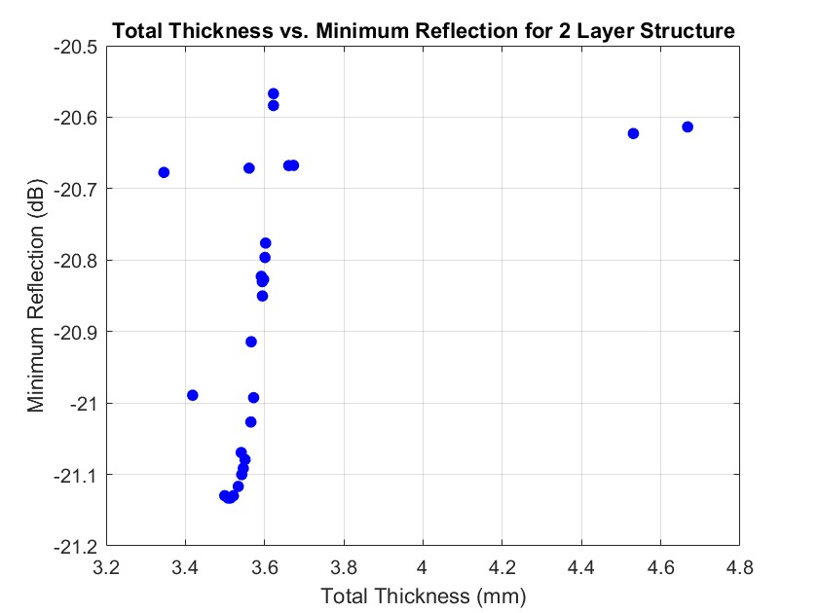
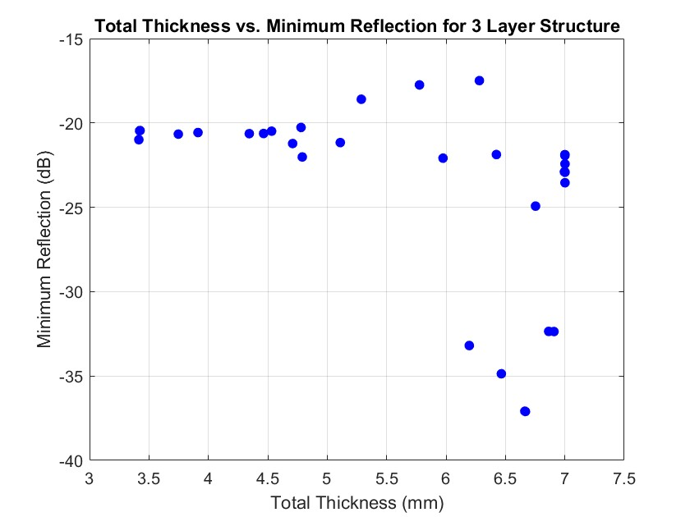
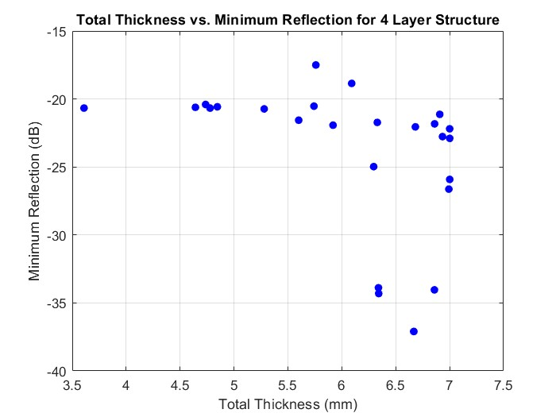
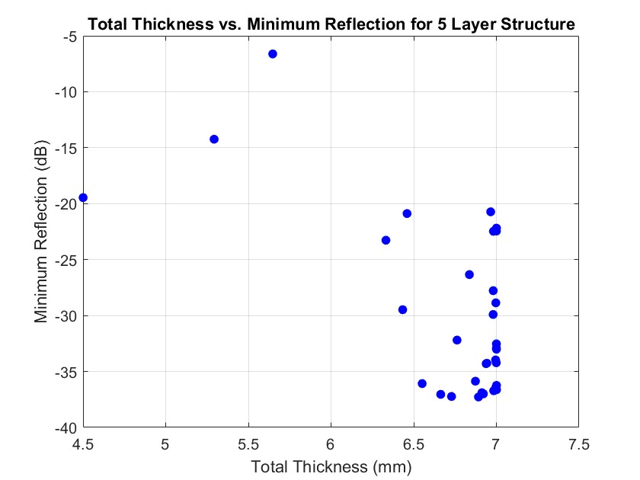
Total Thickness Also Plays a Role in Optimal Reflection Values

Slide 26
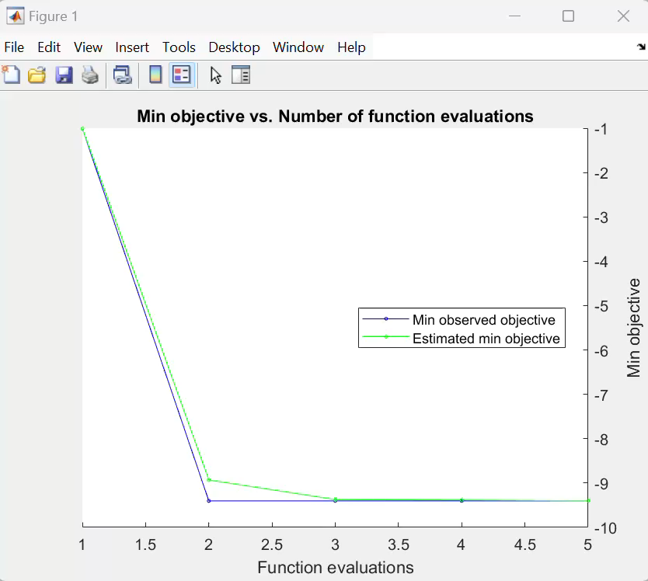
Bayesian Optimization: Enhancing Solutions
Through Informed Search
Probabilistic Model
Use of Acquisition Function to Balance of Exploration and Exploitation

Slide 27
Genetic Algorithm vs Bayesian Optimization
 | GA | Bayesian
Average Run Time | 1.01 (minute) | 70.42 (minutes)
Number of Runs | 10 | 10
Number of Evaluations per Run | 1010 | 1010
Optimal Solution | -20.82 (dB) | -22.36 (dB)

Slide 28
Genetic Algorithm vs Bayesian Optimization
 | GA | Bayesian
Average Run Time | 1.01 (minute) | 70.42 (minutes)
Number of Runs | 10 | 10
Number of Evaluations per Run | 1010 | 1010
Optimal Solution | -20.82 (dB) | -22.36 (dB)

Slide 29
Genetic Algorithm vs Bayesian Optimization
 | GA | Bayesian
Average Run Time | 1.01 (minute) | 70.42 (minutes)
Number of Runs | 10 | 10
Number of Evaluations per Run | 1010 | 1010
Optimal Solution | -20.82 (dB) | -22.36 (dB)

Slide 30
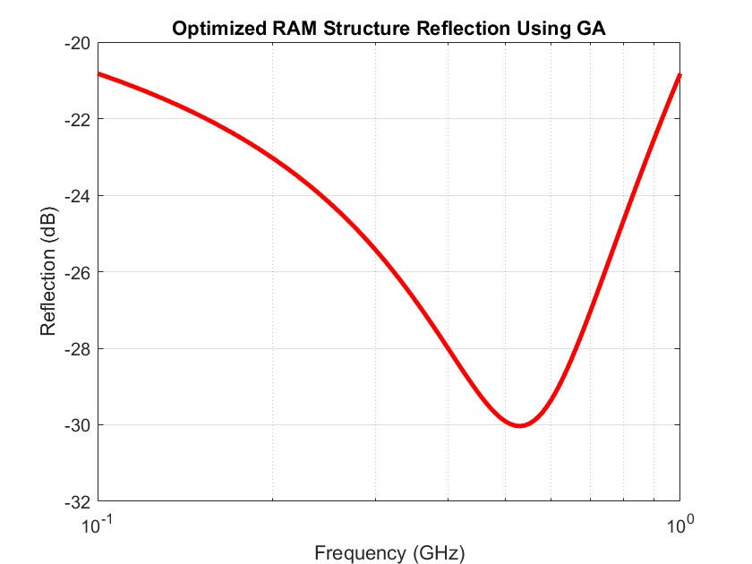
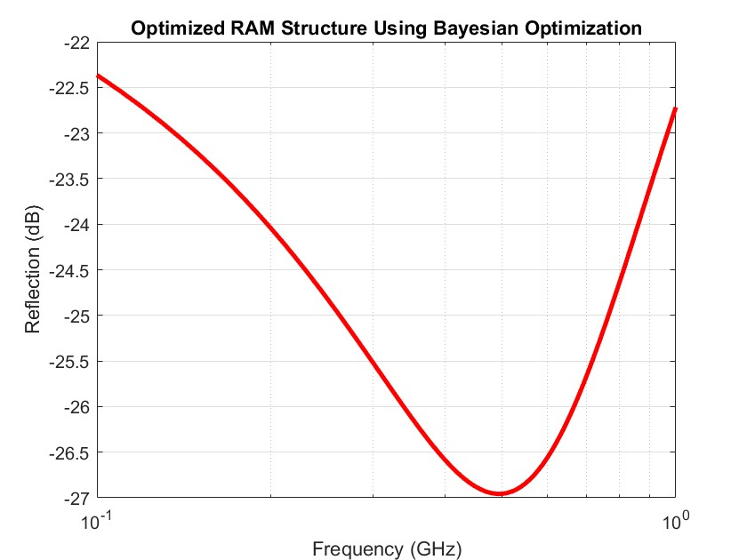
Comparing the Results for Bayesian Optimization and Genetic Algorithm
Genetic Algorithm:
Bayesian Optimization:

Slide 31
Make a Template for ARL to Import Materials
The Material Must be Thin and Easy to Manufacture
Import 16 fictious materials
Create air and PEC layers surrounding material
Maximum of 5 materials thick
Total material thickness < 7 mm
Requirements
&
Specifications
Minimize Total Radar Reflection
Efficiently Execute
MATLAB & Python Scripts
Keep reflection of broad-band frequencies under –30 dB
Vectorize FOR Loops
Genetic Algorithm (GA)
Bayesian Optimization

Slide 32
Make a Template for ARL to Import
Materials
Import 16 fictious materials
Create air and PEC layers surrounding material

Slide 33

Make a Template for ARL to Import
Materials
Import 16 fictious materials
Create air and PEC layers surrounding material

Slide 34
Make a Template for ARL to Import
Materials
Import 16 fictious materials
Create air and PEC layers surrounding material
Given:
Relative Permeability (μ)
Relative Permittivity (ε)

Slide 35
Make a Template for ARL to Import
Materials
Import 16 fictious materials
Create air and PEC layers surrounding material
Given:
Relative Permeability (μ)
Relative Permittivity (ε)
Calculate:
Refractive Index (n)
Extinction Coefficient (k)

Slide 36
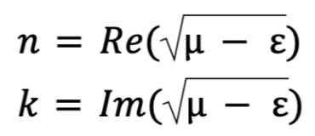
Make a Template for ARL to Import
Materials
Import 16 fictious materials
Create air and PEC layers surrounding material
Given:
Relative Permeability (μ)
Relative Permittivity (ε)
Calculate:
Refractive Index (n)
Extinction Coefficient (k)

Slide 37
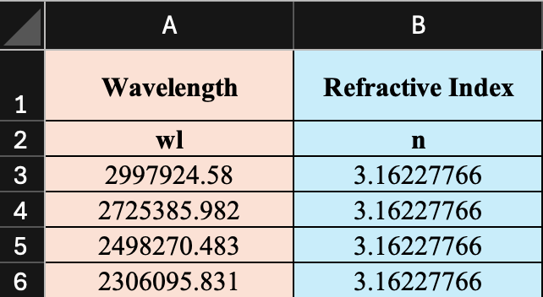
Make a Template for ARL to Import
Materials
Import 16 fictious materials
Create air and PEC layers surrounding material
Create csv file for each material:
Given:
Relative Permeability (μ)
Relative Permittivity (ε)
[nm]
[-]
Calculate:
Refractive Index (n)
Extinction Coefficient (k)

Slide 38

Make a Template for ARL to Import
Materials
Import 16 fictious materials
Create air and PEC layers surrounding material
Air:
n = 1
k = 0
Integrated into the codebase
PEC:
n = 0
k = ∞

Slide 39
The Material Must be Thin and Easy to Manufacture
Maximum of 5 materials thick
Total material thickness < 7 mm

Slide 40

The Material Must be Thin and Easy to Manufacture
Maximum of 5 materials thick
Total material thickness < 7 mm
2 Layer:
t = 3.51 [mm]
3 Layer:
t = 6.66 [mm]
4 Layer:
t = 6.82 [mm]
5 Layer:
t = 6.88 [mm]

Slide 41
Efficiently Execute
MATLAB & Python Scripts
Vectorize FOR Loops
Genetic Algorithm (GA)
Bayesian Optimization

Slide 42

Efficiently Execute
MATLAB & Python Scripts
Vectorize FOR Loops
Genetic Algorithm (GA)
Bayesian Optimization
MATLAB Run Time:
Non-Vectorized: 11.24 (sec)
Vectorized: 2.46 (sec)

Slide 43
Efficiently Execute
MATLAB & Python Scripts
Vectorize FOR Loops
Genetic Algorithm (GA)
Bayesian Optimization

Slide 44
Efficiently Execute
MATLAB & Python Scripts
Vectorize FOR Loops
Genetic Algorithm (GA)
Bayesian Optimization

Slide 45
Minimize Total Radar Reflection
Keep reflection of broad-band frequencies under –30 dB

Slide 46
Minimize Total Radar Reflection
Keep reflection of broad-band frequencies under –30 dB
2 Layer:
R = -21.13 (dB)
3 Layer:
R = -37.10 (dB)
4 Layer:
R = -36.46 (dB)
5 Layer:
R = -37.28 (dB)

Slide 47
Semester Summary: Highlights and Insights
Budget: 72.69 (seconds) to Run Code at 100 populations and 100 generations
Engineer Cost per Hour: $150
$3 per run

Slide 48

The Work Done in MATLAB Will Be
Transferred to Python
Transition to Python
  Recreate genetic algorithm, Bayesian Optimization in Python
Enhanced Functionality
  Incorporate machine learning and deep learning models.
Improved Efficiency
  Optimize code to run faster with larger data sets
Scalability
  Further develop material database
Real-World Testing
  Create physical models of material layers

Slide 49
Sources:
[1.] Michielssen, E., et al. “Design of lightweight, broad-band microwave absorbers using genetic algorithms.” IEEE Transactions on Microwave Theory and Techniques, vol. 41, no. 6, 1993, pp. 1024–1031, https://doi.org/10.1109/22.238519.
[2.] Kilic, Ozlem, and Q. M. Nguyen. “Application of artificial immune system algorithm to electromagnetics problems.” Progress In Electromagnetics Research B, vol. 20, 2010, pp. 1–17, https://doi.org/10.2528/pierb10010701.

